Slide 1
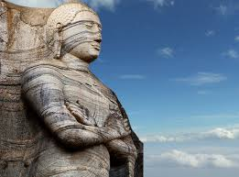

Slide 2
wdkdmdk i;s Ndjkd
folla we;‘ njg idË‘

Slide 3
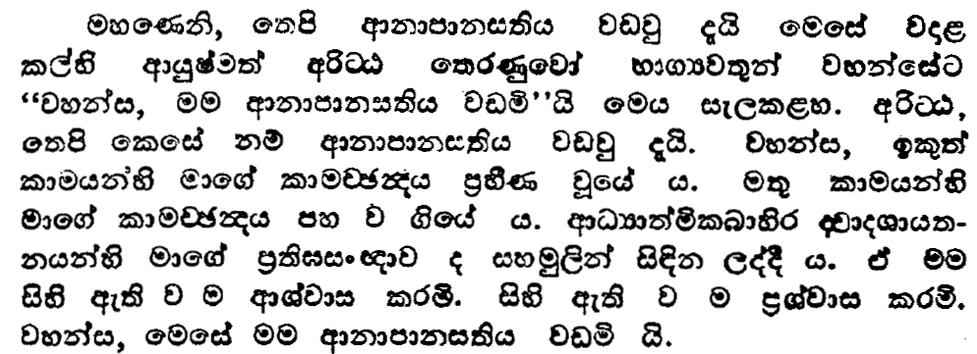
047
ix5-2
wßÜG iQ;%h
97msg

Slide 4
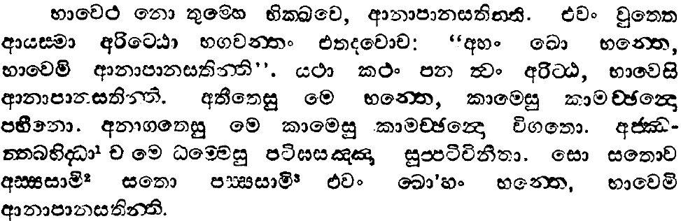
048
ix5-2
wßÜG iQ;%h
96msg

Slide 5
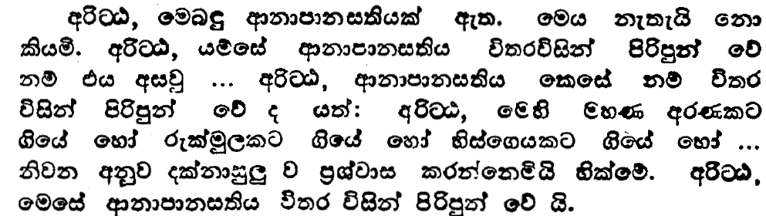
047
ix5-2
wßÜG iQ;%h
97msg

Slide 6
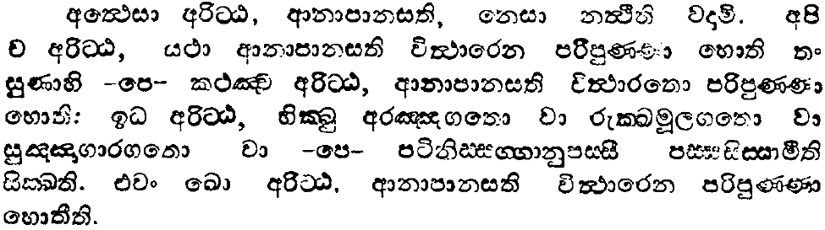
048
ix5-2
wßÜG iQ;%h
96msg

Slide 7
wdkdmdk i;s Ndjkd
folla we;

Slide 8
OHdk l‘r’ug
ukisldr l, hQ;=
wruqk l=ulao@

Slide 9
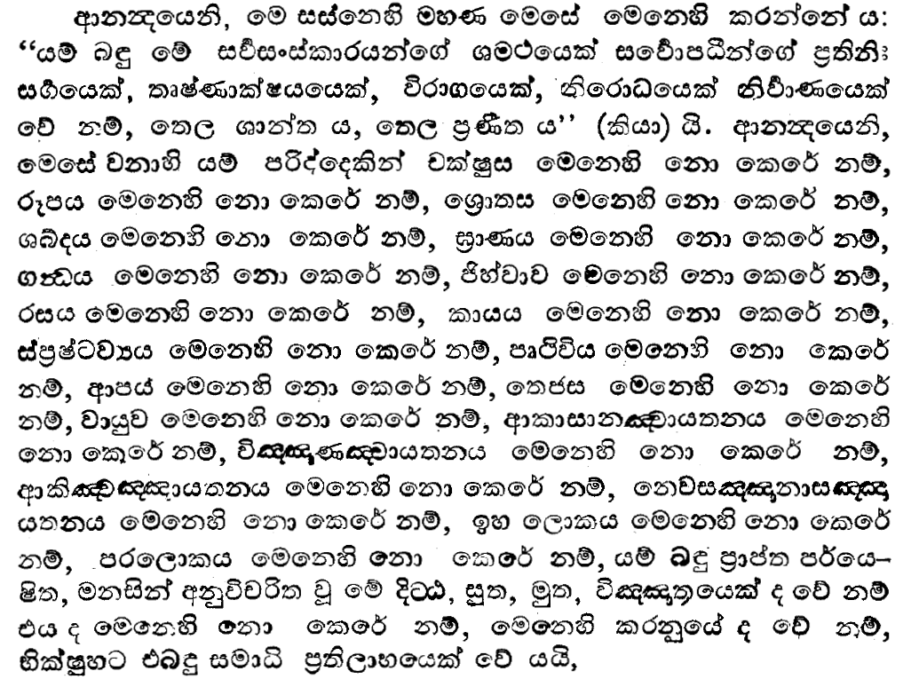
ukisldr iQ;%h
wx.=-6
foaikdydrjsNx.h
607 msg
fk;a;s
19 msg

Slide 10
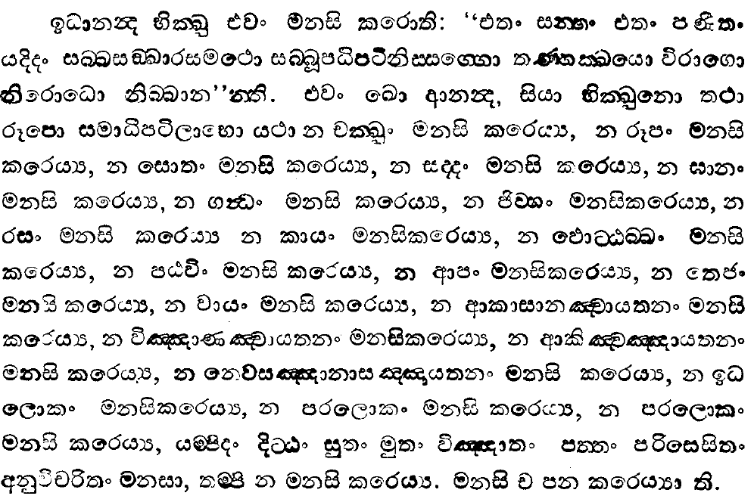
ukisldr iQ;%h
foaikdydrjsNx.h
wx.=-6
m[apXÕsl iudOs iQ;%h
fk;a;s
wx-3
19 msg
39 msg
606msg

Slide 11
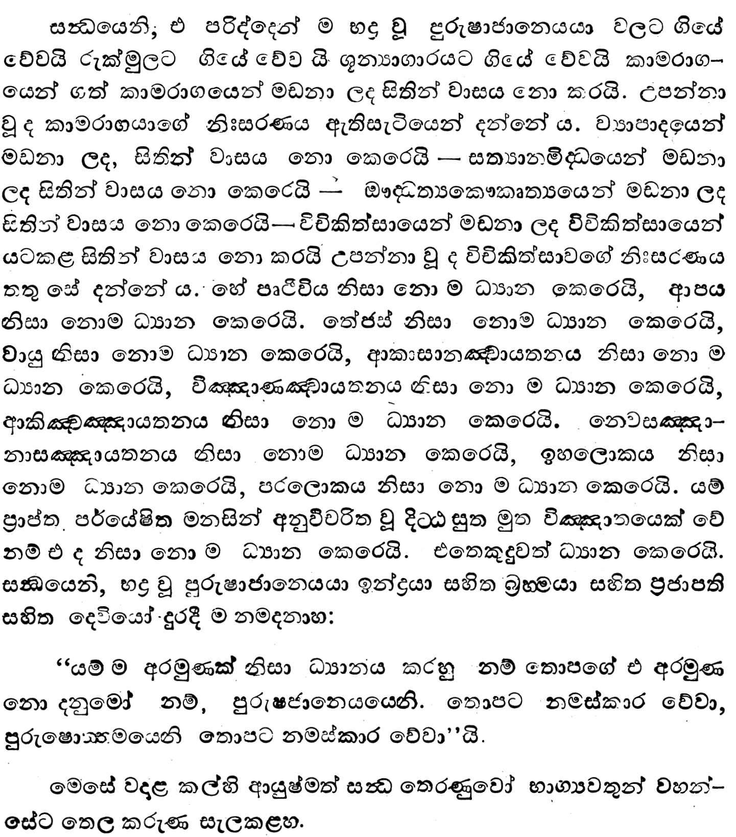
wx.=-6
ikaO iQ;%h
613msg

Slide 12
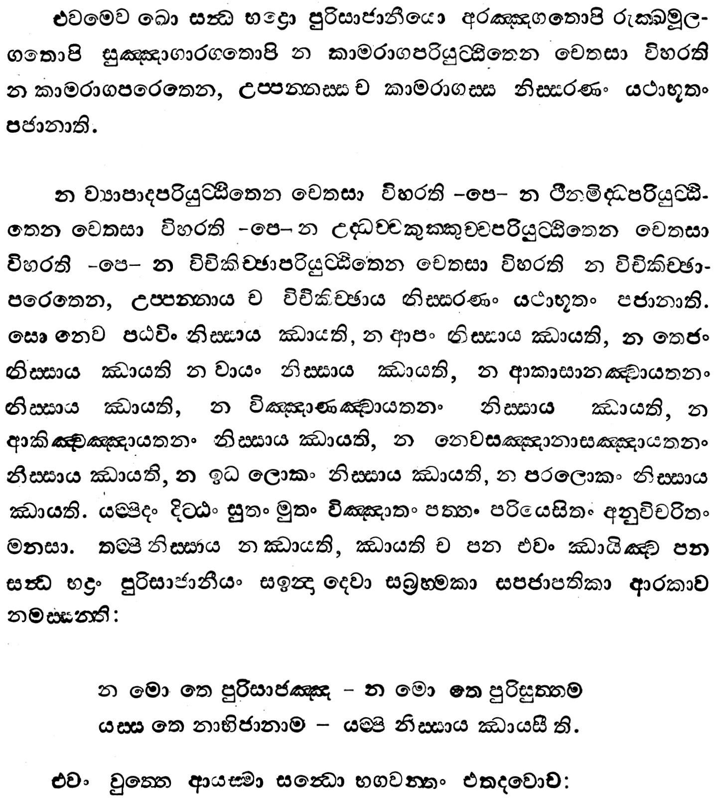
wx.=-6
ikaO iQ;%h
612msg

Slide 13
wx.=-6
ikaO iQ;%h
613msg

Slide 14
wx.=-6
ikaO iQ;%h
612msg

Slide 15
wx.=-6
ikaO iQ;%h
613msg

Slide 16
OHdk l‘r’ug
ukisldr l, hQ;af;a
f,dalhg wh;a fkdjk wdrïukhla jk
¥gq ksjkhs

Slide 17
ukisldr l, hQ;af;a
uqL ksñ;a; fyj;a
ÿgq ksjk
nj

Slide 18
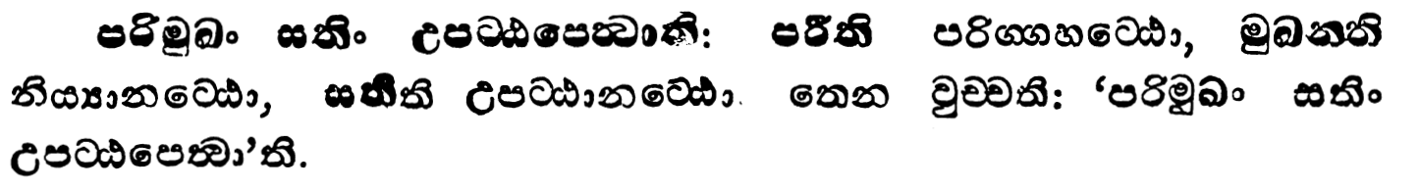
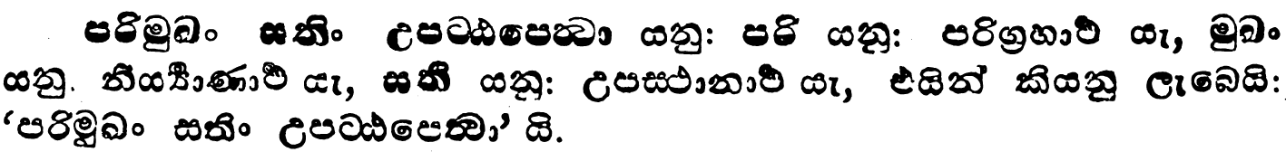
máix-1
wdkdmdk iauD;s l:d $if;dß×k ks¾foaYh
332 msg

Slide 19
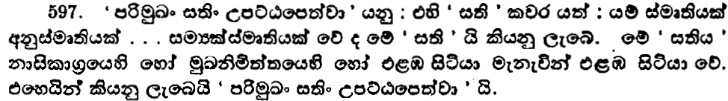
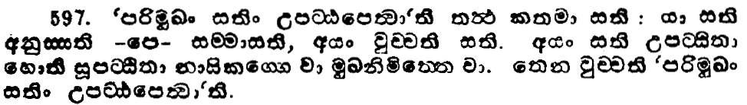
úNx.-2
OHdk úNx.h
47 msg

Slide 20
ukisldr l, hQ;af;a
uqL ksñ;a;
kdi‘ld.%h fyj;a
ÿgq ksjkh‘

Slide 21
jdhqj iufldg njqka jvk wdkdmdk i;sh

Slide 22
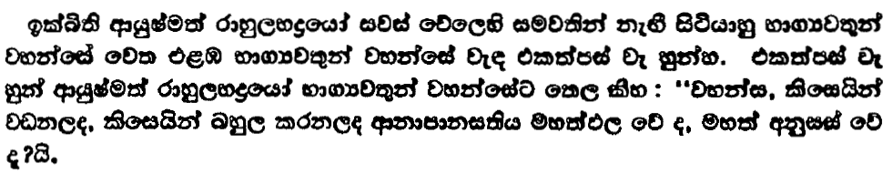
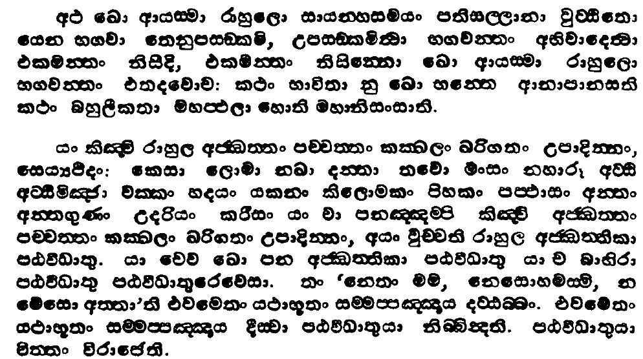
049
uyd rdyqf,dajdo iQ;%h
uca-2
143msg

Slide 23
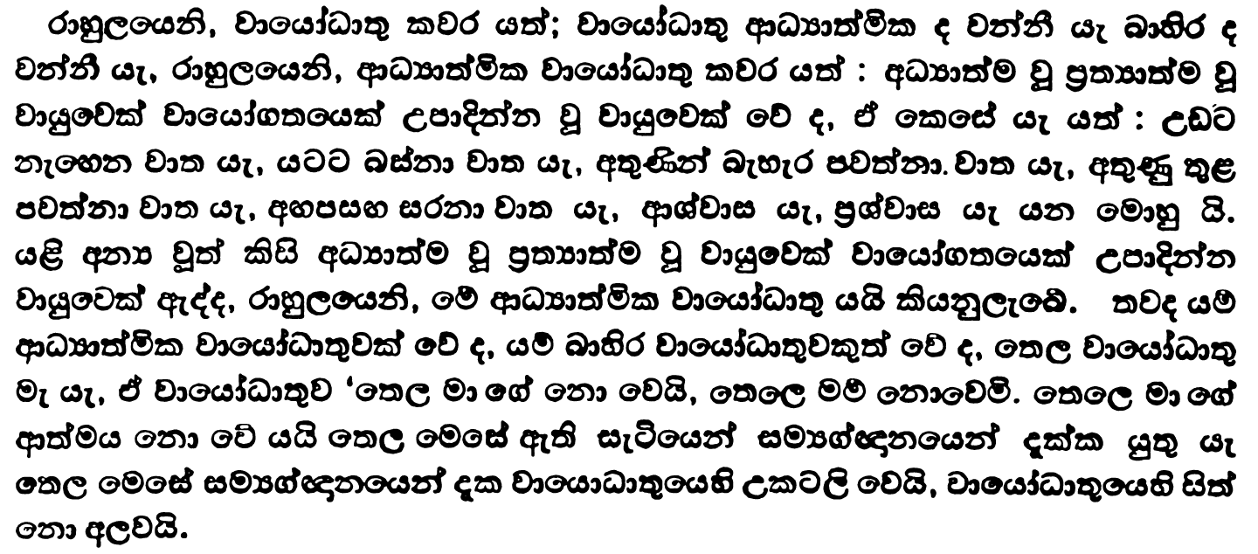
049
uyd rdyqf,dajdo iQ;%h
uca-2
143msg

Slide 24
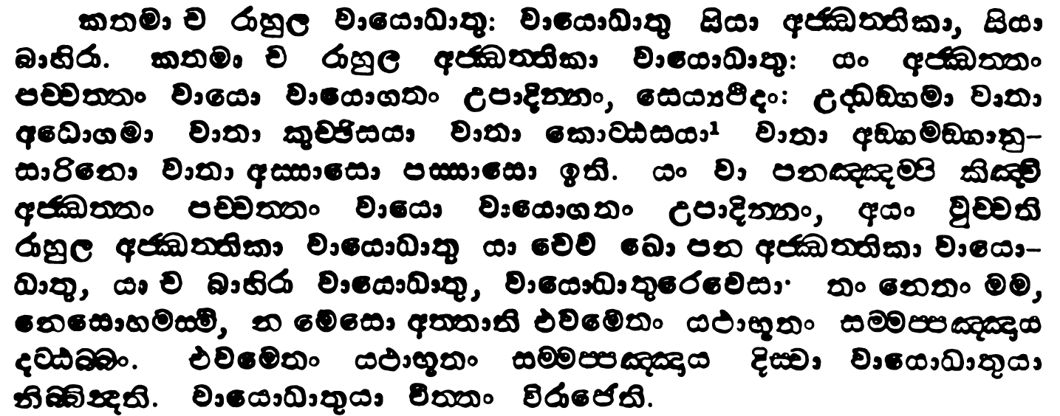
050
uyd rdyqf,dajdo iQ;%h
uca-2
142msg

Slide 25
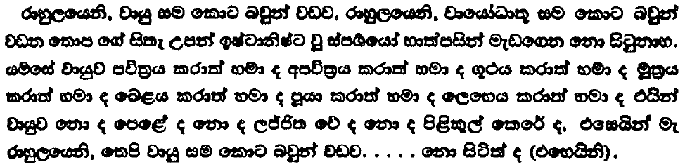
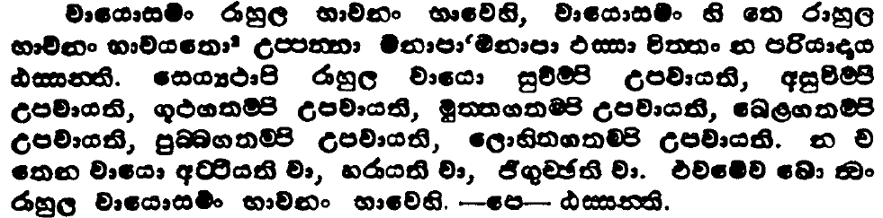
051
uca-2
uyd rdyqf,dajdo iQ;%h
147msg

Slide 26
by; k‘jka u.g
yqiau
iïnkao ke;

Slide 27
i‘;
m‘ßi‘ÿ lr ksjka olsuq

Slide 28
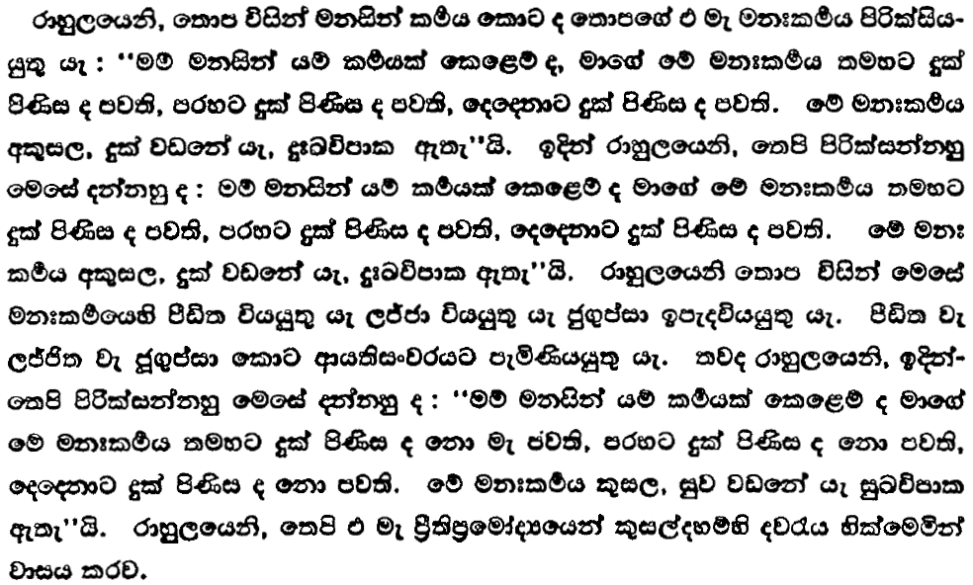
uca-2
wïn,ÜÀlrdyqf,dajdo iQ;%h
139msg

Slide 29
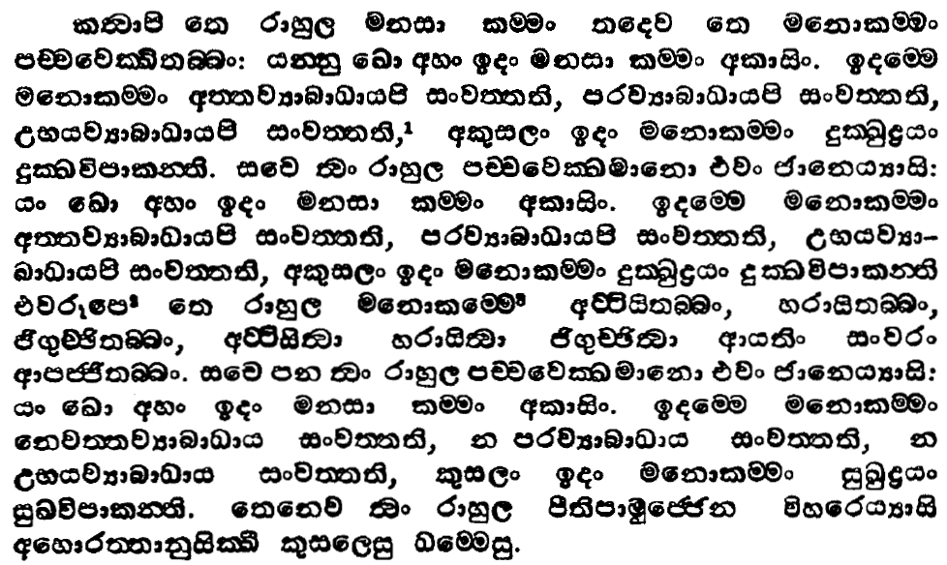
uca-2
wïn,ÜÀlrdyqf,dajdo iQ;%h
138msg

Slide 30
taflfiao@

Slide 31
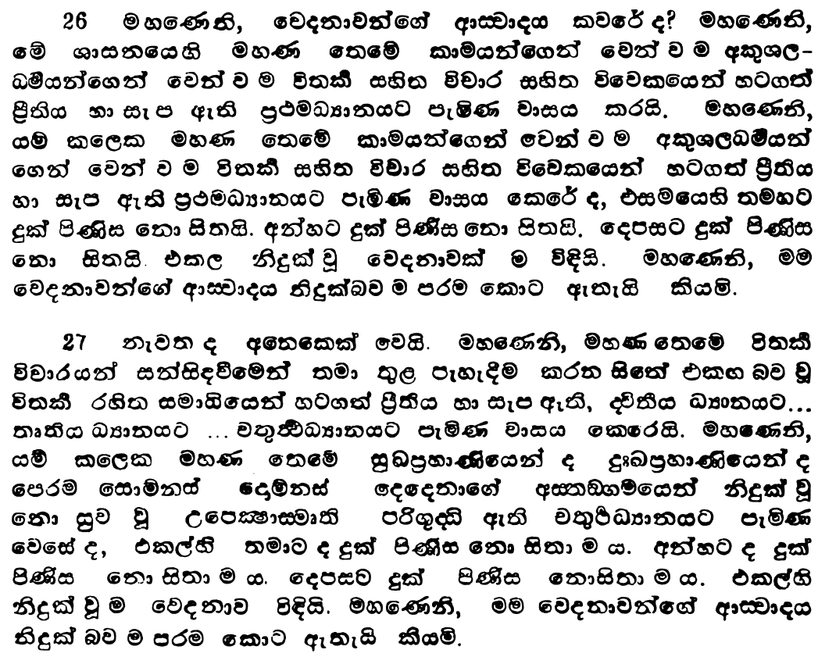
uÊ-1
uydÿlaLlaLkaO iQ;%h
213msg

Slide 32
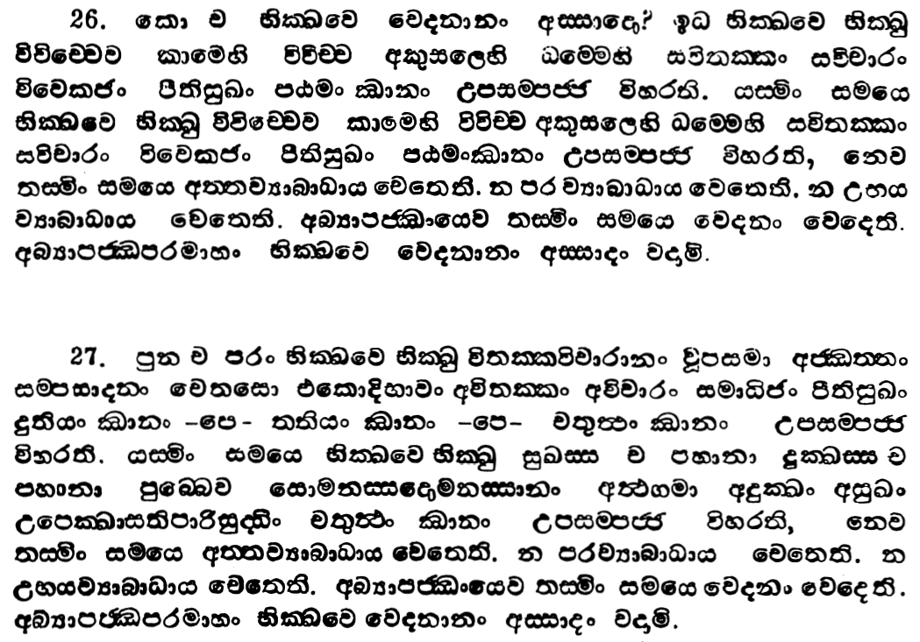
uÊ-1
uydÿlaLlaLkaO iQ;%h
212 msg

Slide 33
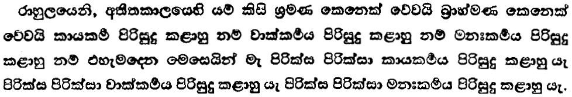
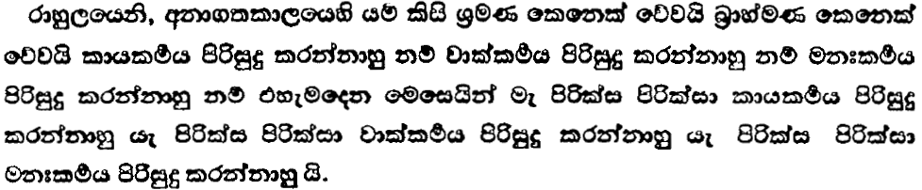
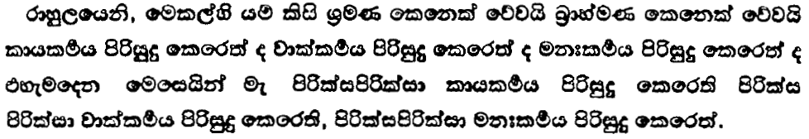
uca-2
wïn,ÜÀlrdyqf,dajdo iQ;%h
139msg

Slide 34
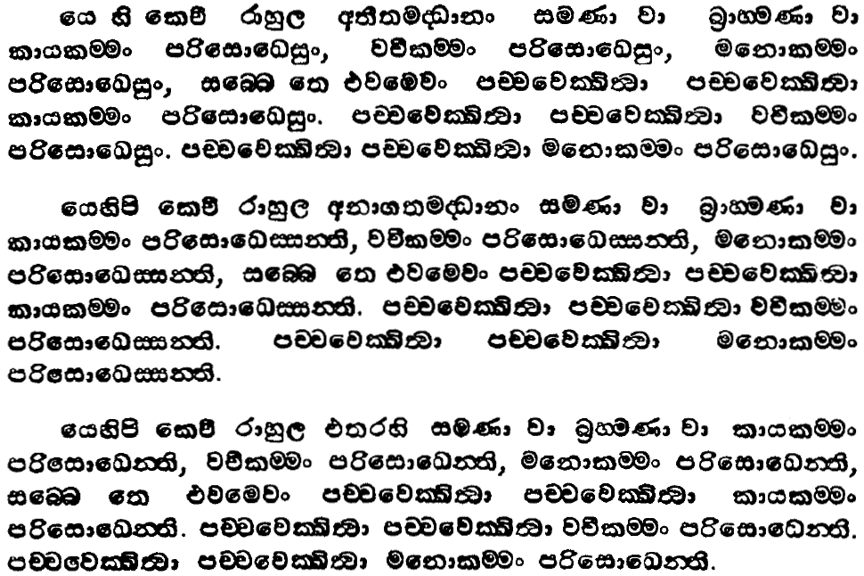
uca-2
wïn,ÜÀlrdyqf,dajdo iQ;%h
138msg

Slide 35
by; k‘jka u.g
yqiau
iïnkao ke;

Slide 36
wdkdmdk i;s Ndjkdjg
isysh ;nd.; hq;af;a
ÿgq ksjfka nj

Slide 37
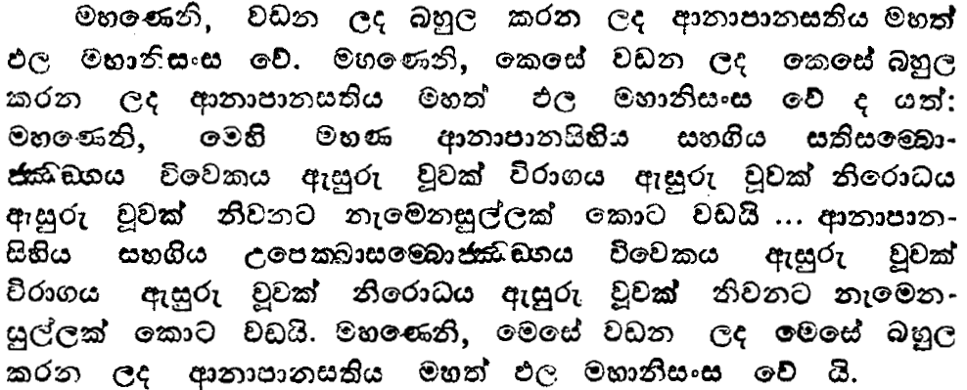
ix5-2
fndc®X. iQ;%h
93msg

Slide 38
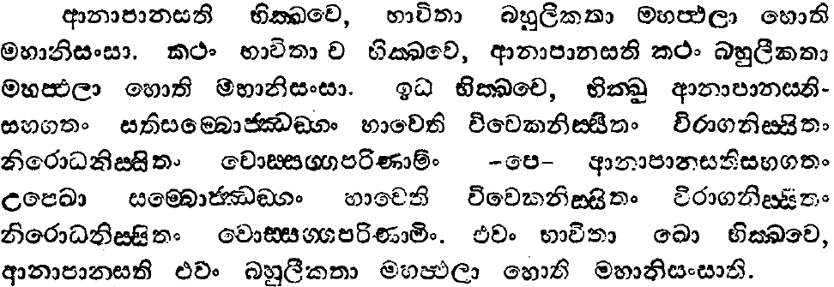
ix5-2
fndc®X. iQ;%h
92msg

Slide 39
by; k‘jka u.go
yqiau
iïnkao ke;

Slide 40
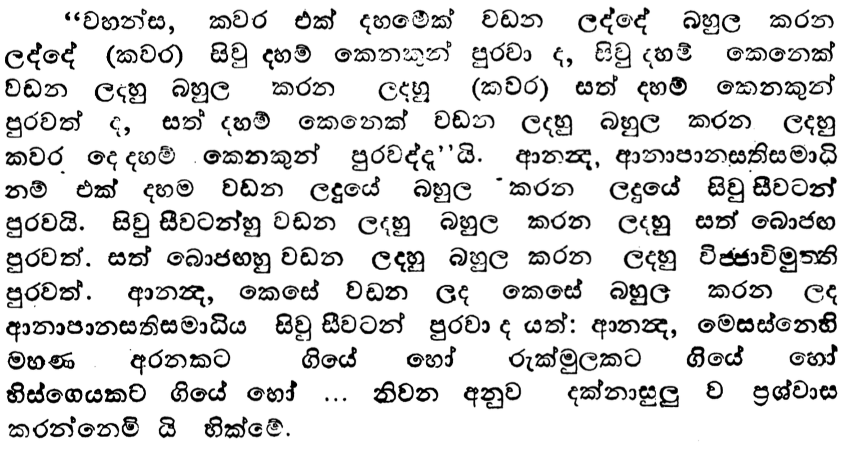
ix5-2
wdkkao iQ;%h
119msg

Slide 41
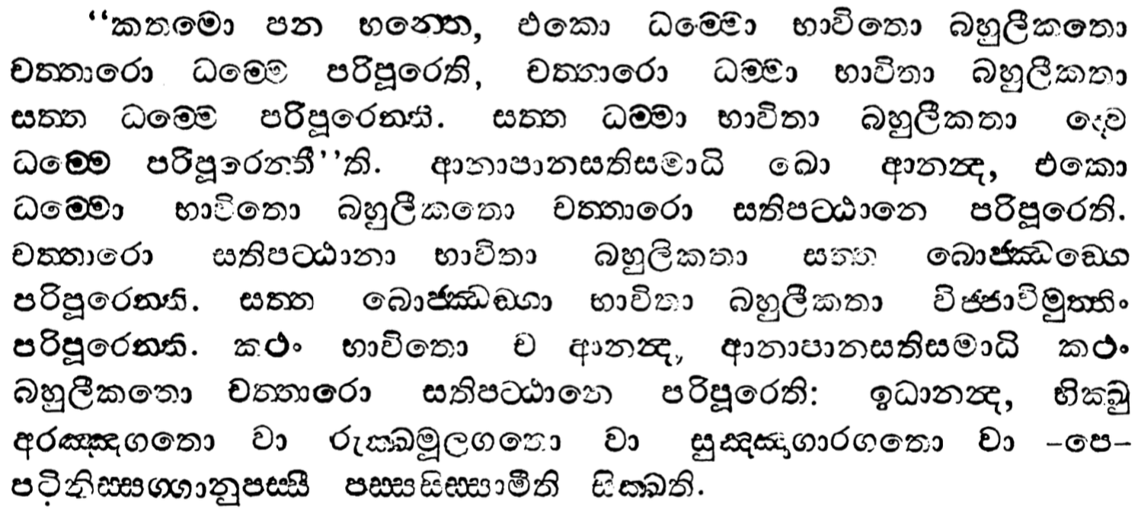
053
ix5-2
wdkkao iQ;%h
118msg

Slide 42
wdkdmdk i;s Ndjkdjg
isysh ;nd.; hq;af;a
f,dal wruqkl fkdj
ÿgq ksjfkah

Slide 43
;:d.; foaYkdj
l=ula i|ydo@

Slide 44
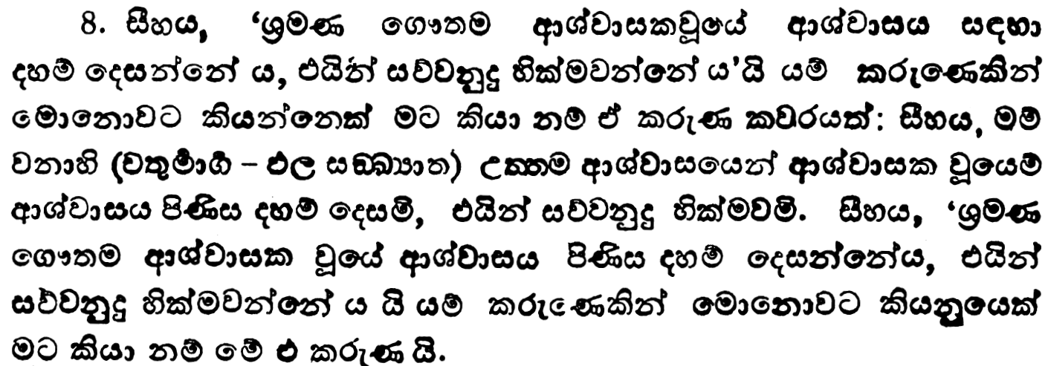
056
wx.=-5
i’yfiakdm;‘ iQ;%h
61msg

Slide 45
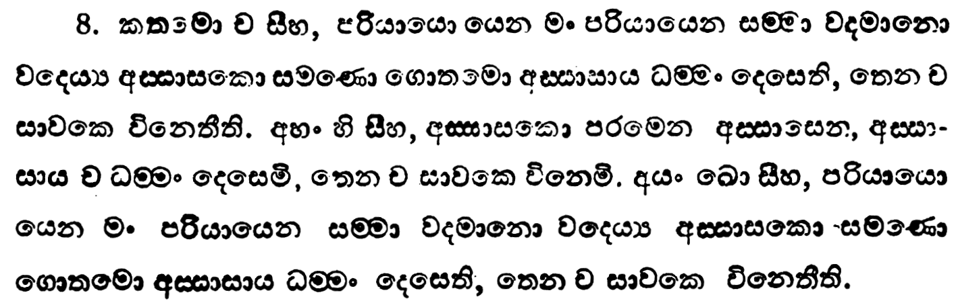
057
wx.=-5
i’yfiakdm;‘ iQ;%h
60msg

Slide 46
;:d.; foaYkdj
wiaidih
Wfoidh‘

Slide 47

wd¾h idikfha
wiaidih
hkq l=ulao?

Slide 48
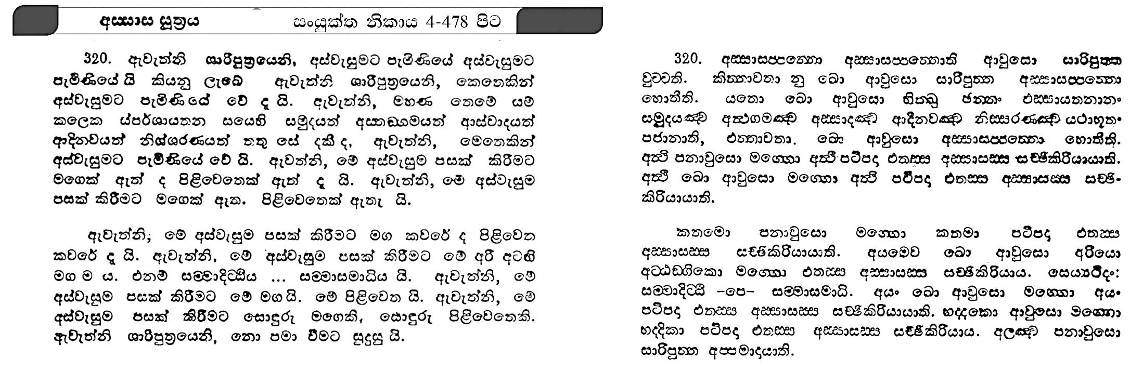
28
ix - 4
wiidi iq;%h
479 msg

Slide 49
29
ix - 4
wiidi iq;%h
478 msg

Slide 50
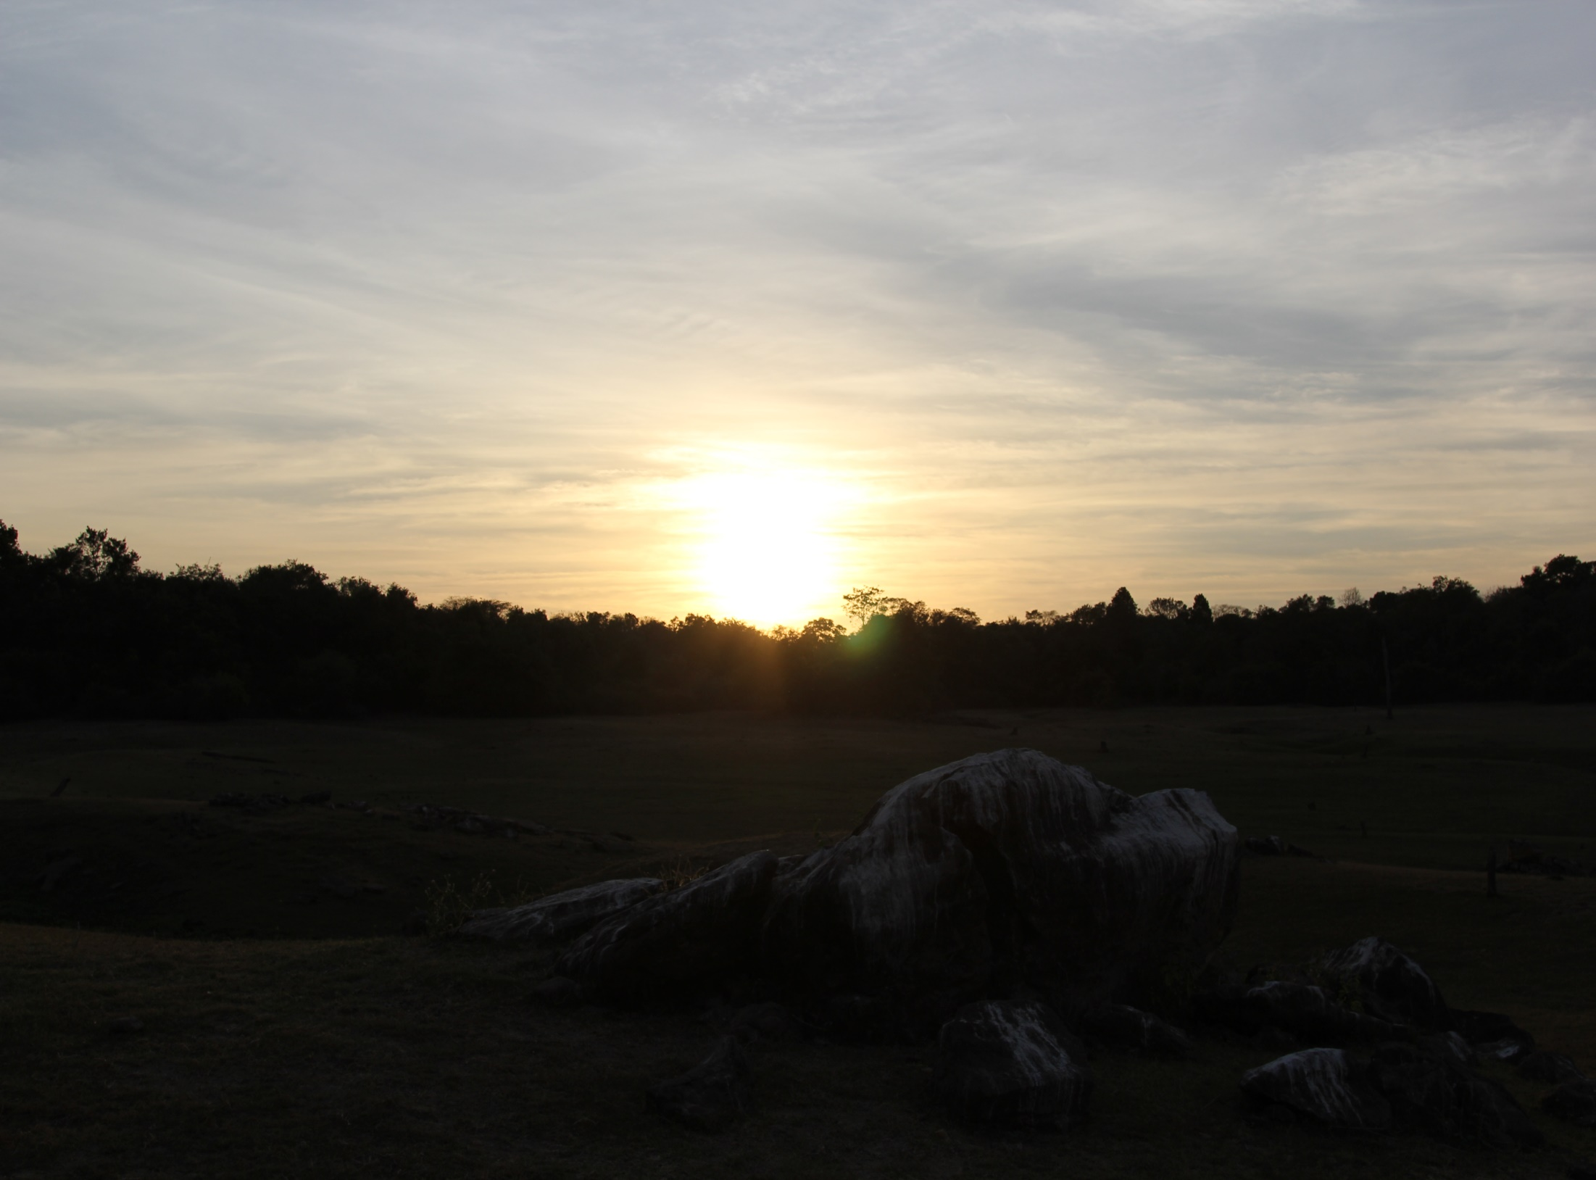
wd¾h idikfha mruiaidih
hkq l=ulao @

Slide 51
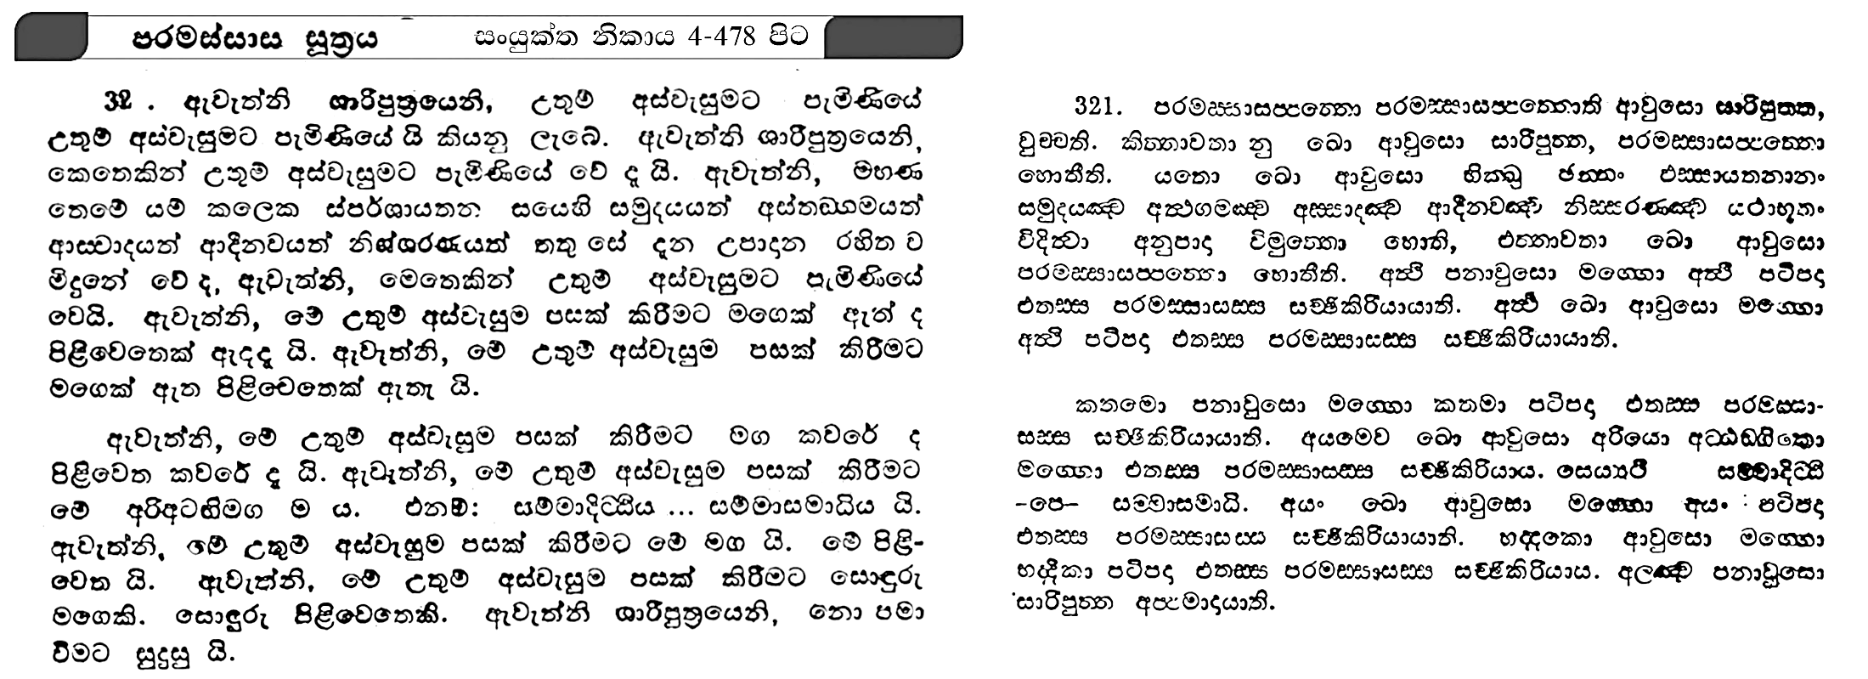
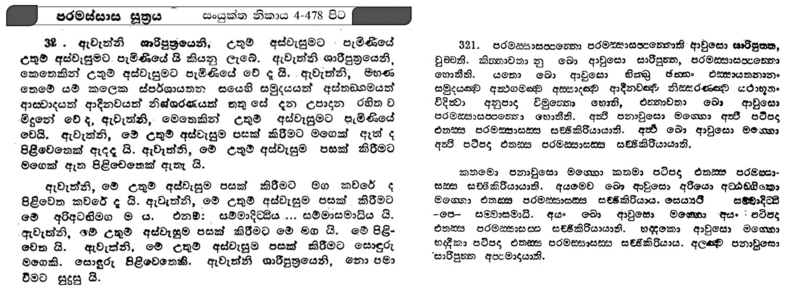
30
ix - 4
mruiaidh iq;%h
479 msg

Slide 52

ix -4
mruiaidh iq;%h
478 msg

Slide 53
wdkdmdki;s
Ndjkdj
fjk;a whqrl‘ka

Slide 54
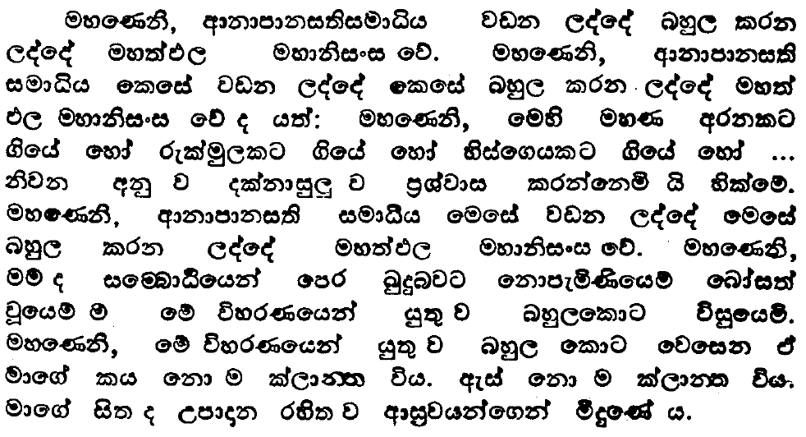
060
ix5-2
oSm iQ;%h
99msg

Slide 55
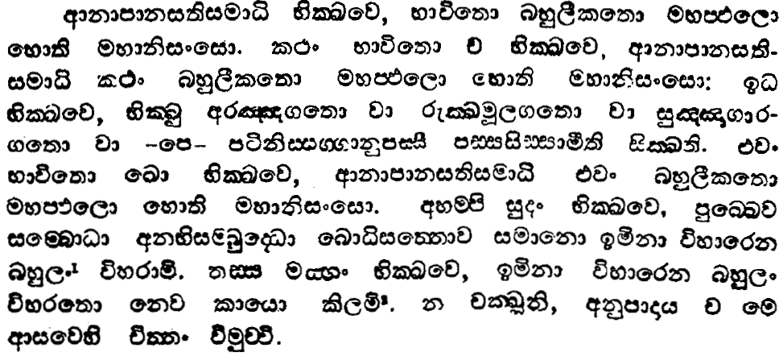
061
ix5-2
oSm iQ;%h
98msg

Slide 56
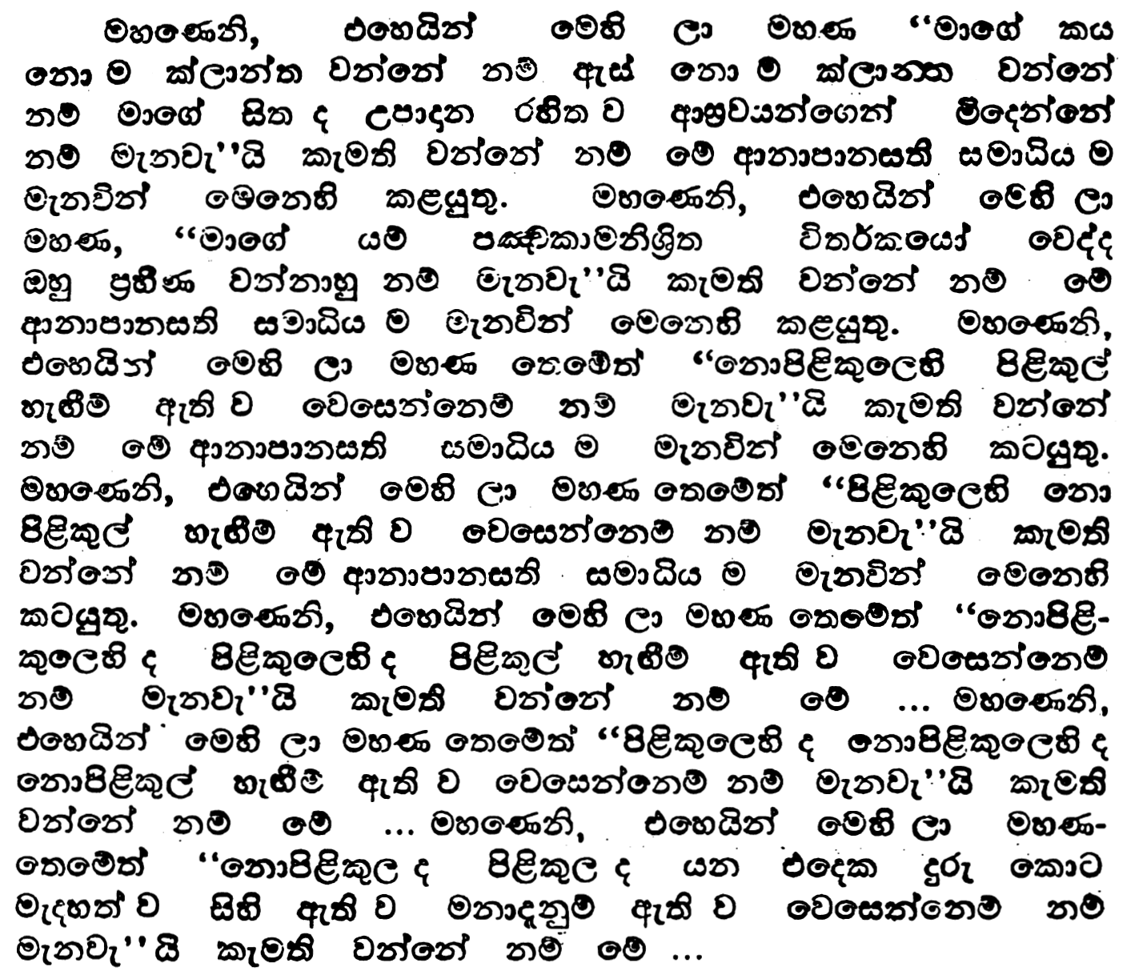
062
ix5-2
oSm iQ;%h
101msg

Slide 57
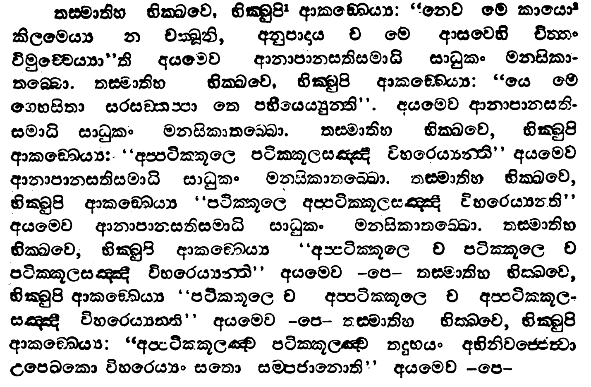
063
ix5-2
oSm iQ;%h
100msg

Slide 58
064
ix5-2
oSm iQ;%h
101msg

Slide 59
065
ix5-2
oSm iQ;%h
100msg

Slide 60
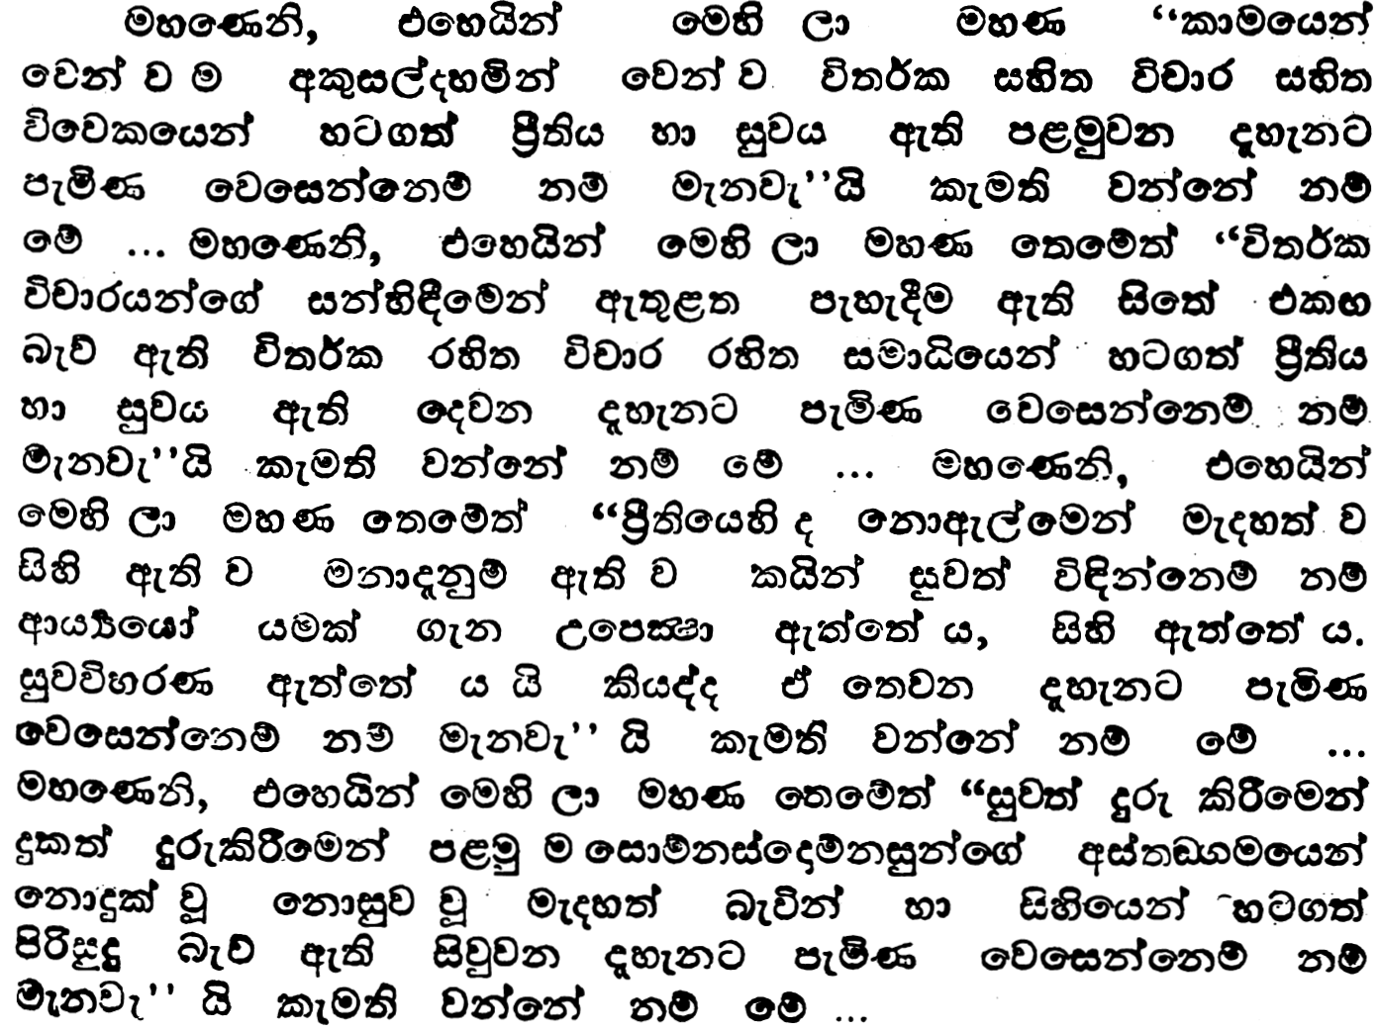
066
ix5-2
oSm iQ;%h
101msg

Slide 61
067
ix5-2
oSm iQ;%h
101msg

Slide 62
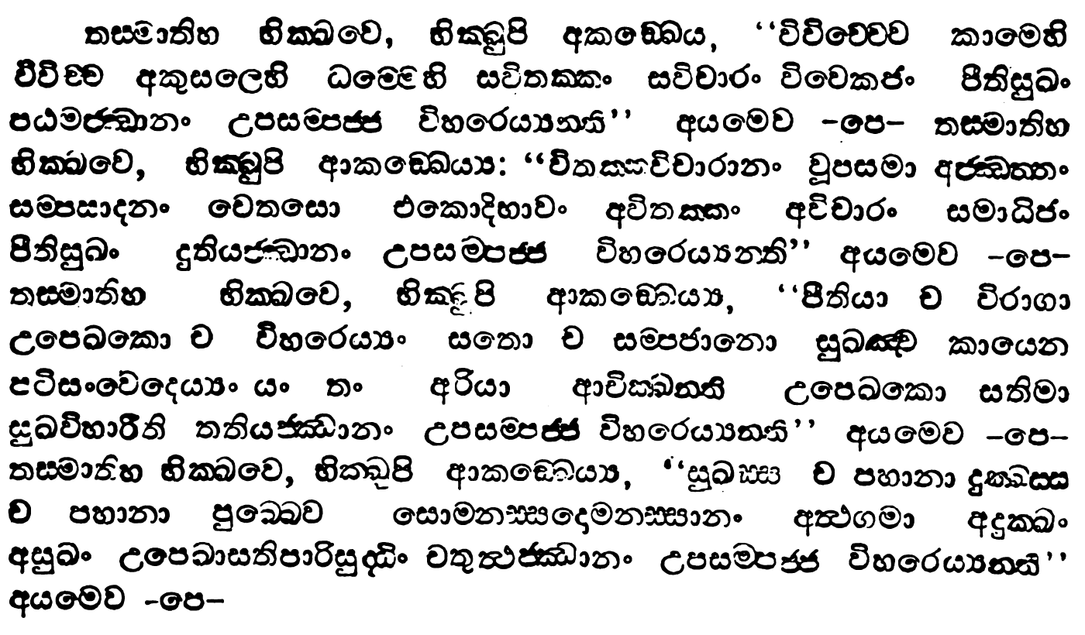
068
ix5-2
oSm iQ;%h
100msg

Slide 63
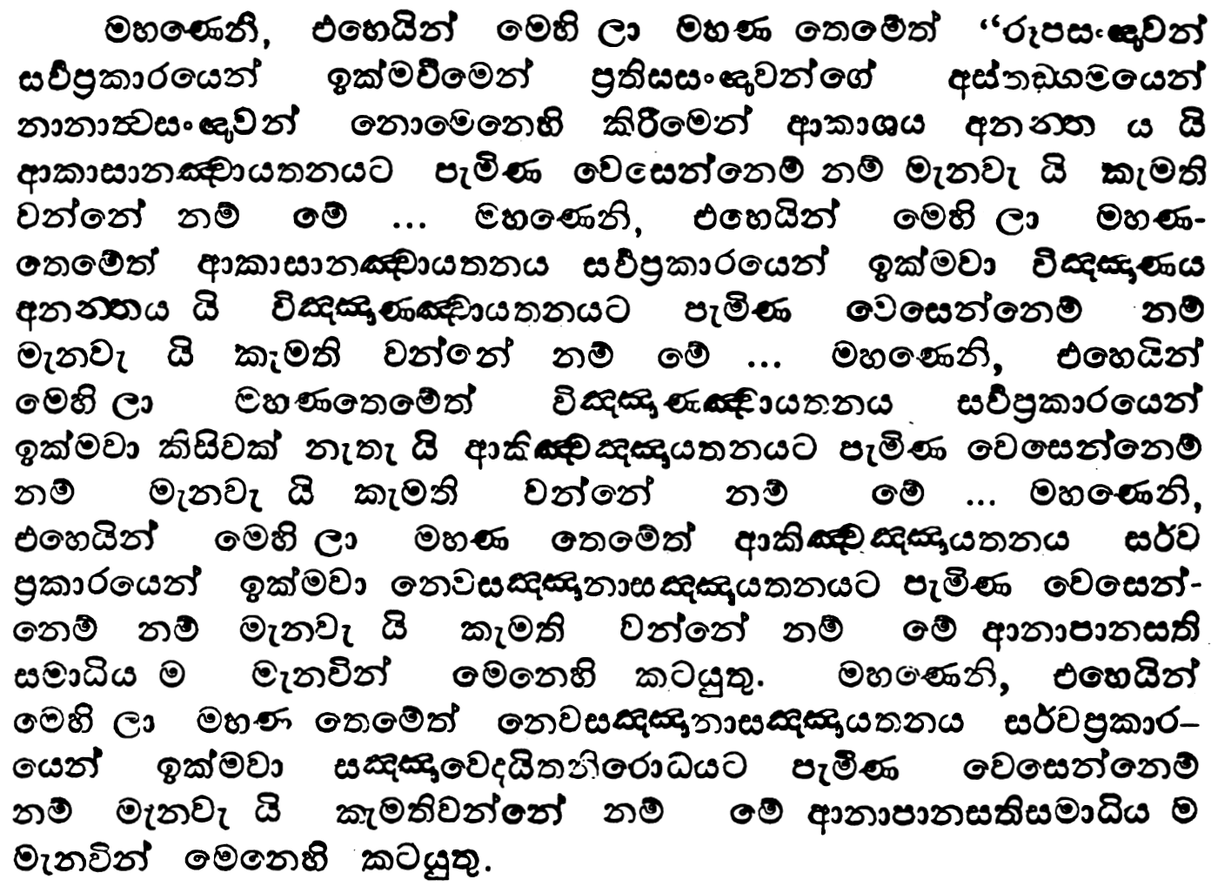
069
ix5-2
oSm iQ;%h
103msg

Slide 64
070
ix5-2
oSm iQ;%h
103msg

Slide 65
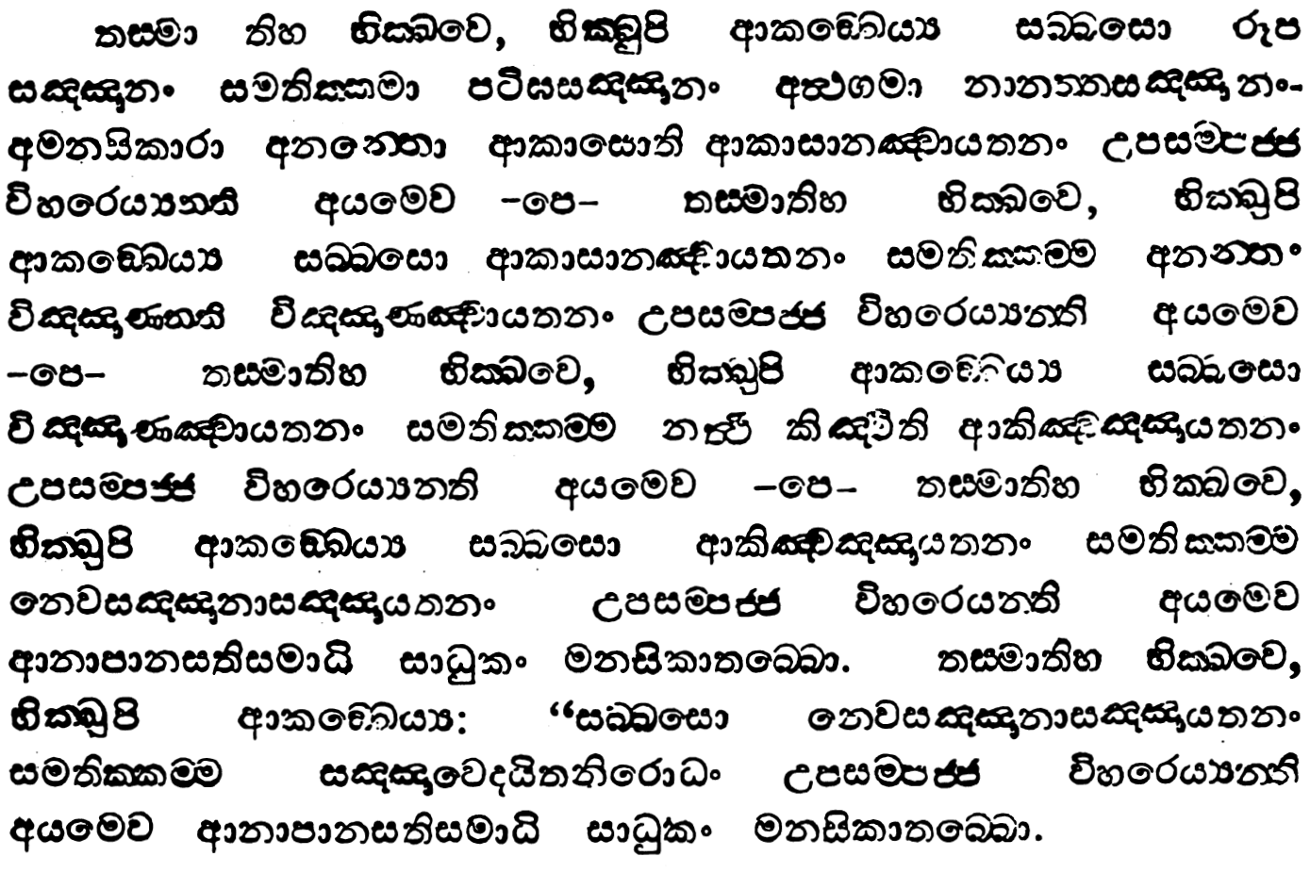
071
ix5-2
oSm iQ;%h
102msg

Slide 66
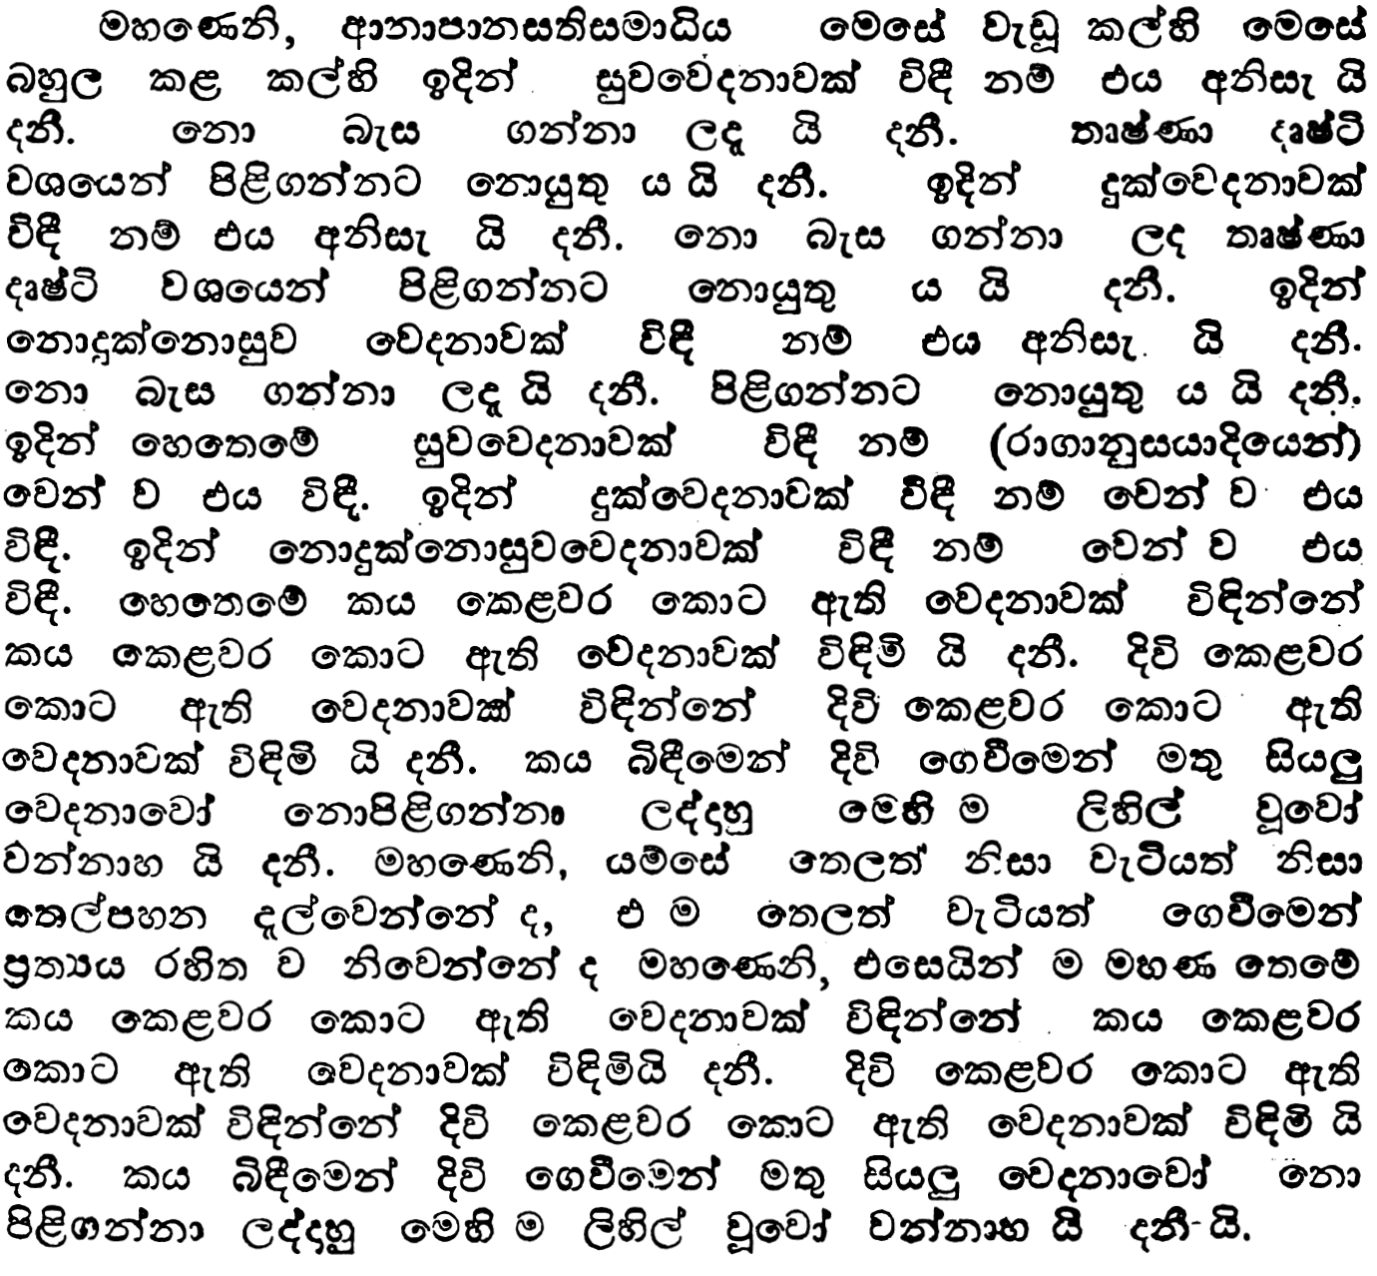
072
ix5-2
oSm iQ;%h
103msg

Slide 67
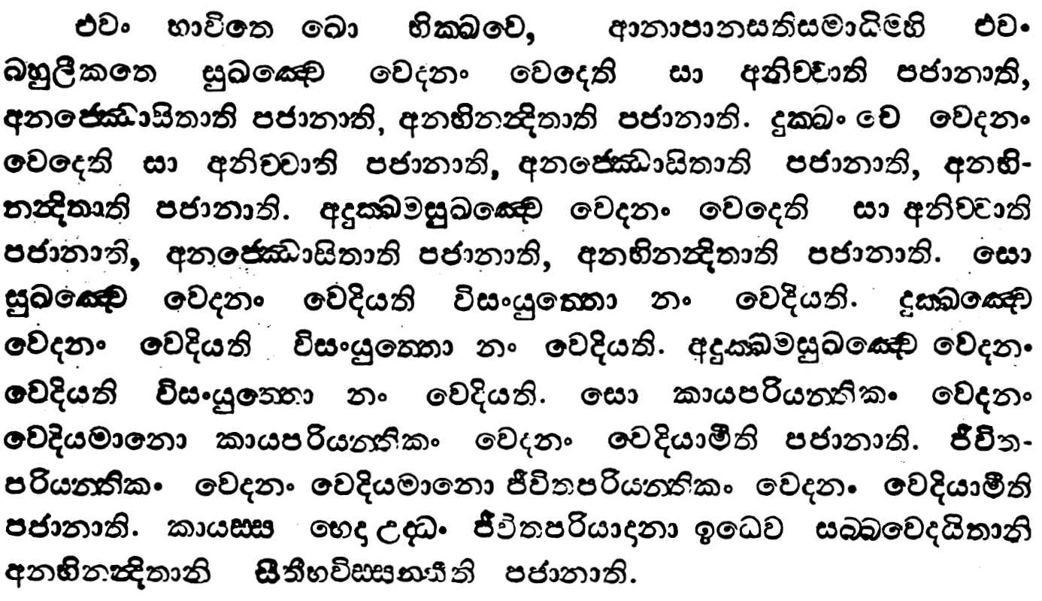
073
ix5-2
oSm iQ;%h
102msg

Slide 68
ix5-2
oSm iQ;%h
103msg

Slide 69
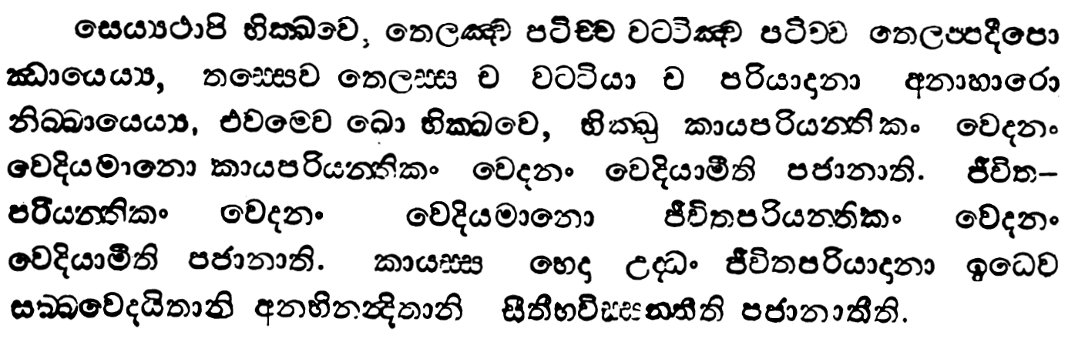
ix5-2
oSm iQ;%h
102msg

Slide 70
wdkdmdki;s Ndjkdj hkq wdiajdofha wd§kjh wiaidi fyj;a weiqre lr
pkaord. ksiairKh fyj;a miaidi l‘r’uh‘

Slide 71
w;’;" wkd.;" j¾;udk hk ;=ka ld,fha wdiajdo keu;‘ ÿl‘ka ñfok u. fláfhka

Slide 72
074
fmgfldmfoafi
275msg

Slide 73
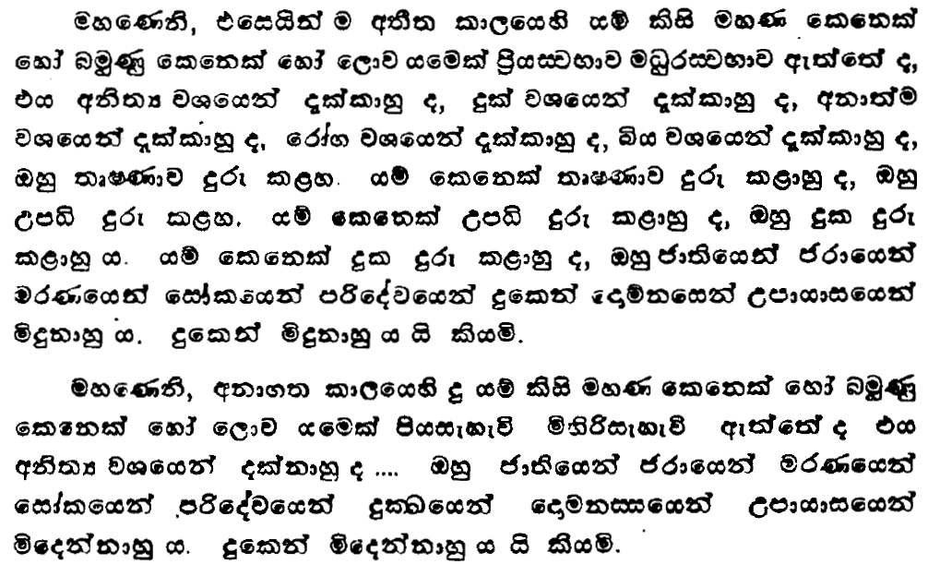
075
ix-2
iïuiaik iQ;%h
175msg

Slide 74
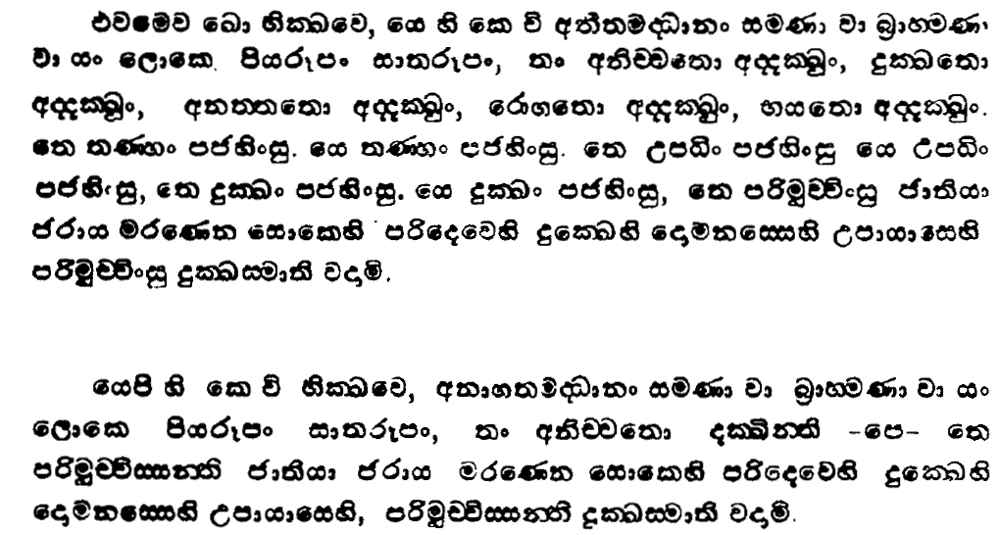
076
ix-2
iïuiaik iQ;%h
174msg

Slide 75

077
ix-2
iïuiaik iQ;%h
175msg

Slide 76

078
ix-2
iïuiaik iQ;%h
174msg

Slide 77
by; k‘jka u.go
yqiau
iïnkao ke;

Slide 78


079
ix-2
ksÞk iQ;%h
144msg

Slide 79


080
ix-2
ksÞk iQ;%h
145msg

Slide 80
by; k‘jka u.go
yqiau
iïnkao ke;

Slide 81
k‘jka u. mQ¾K l‘r’ug l, hq;af;a pkaord. máÉcfhka k‘¾ñ; ixl,am‘; lduh fyj;a wdiajdofha wd§kjh jk wk‘Éc ÿlaL wk;a: oek pkaord. k‘frdaOh muK‘

Slide 82
k‘udj

